Slide 1



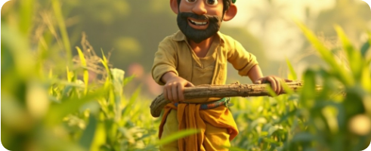









HSBC × BAIF HACKATHON DELIVERABLE
अनुवादिनी
Empowering On-Field Farmers
Providing regional agricultural training content directly at ground level.
An end-to-end local localization engine translating text, audio, and video manuals seamlessly to empower rural Indian agricultural programs.
PRODUCT ENGINEERING TEAM
Rupali Tripathi
Rupali Joshi
Software Engineer
Software Engineer
Rupali Pandey
Rupali Pant
Bridging the Technical Gap
Software Engineer
Software Engineer
High-fidelity speech synthesis and subtitles running 100% offline.

Slide 2


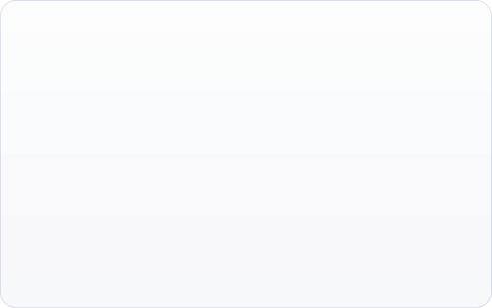

PROBLEM STATEMENT & REQUIREMENTS
Core Challenge
Target Deliverables
"Design, build, and deploy an offline-capable translation application for BAIF that accepts text, audio, and video inputs to empower on-field rural agricultural programs."
Input Media Formats: MP4, MOV, MKV, AVI, MP3, WAV, AAC, TXT
Language Triad: Marathi, Hindi, English
Multi-Core Deliverables: Automatic Speech Recognition (ASR), translation preservation, local TTS Synthesis & Subtitle Burns
Unreliable Field Internet: Solutions must perform 100% locally on BAIF's on-premises low-spec local machinery.
Media Disjointedness: On-field manuals are heavily fragmented across documents, audio instructions, and videos.
Licensing Constraints: 100% open-source packages with ₹0 execution overhead or cloud API bills

Slide 3








SOLUTION ARCHITECTURE
Ingestion
Core Processor
Synthesis
Outputs
Accepts raw media formats with automated verification loops.
Handles on-premises speech recognition and contextual translation.
Generates high-fidelity voices and scales Devanagari text streams.
Fuses layers natively using local execution libraries.
OPEN-SOURCE CORE DEPENDENCIES

Slide 4
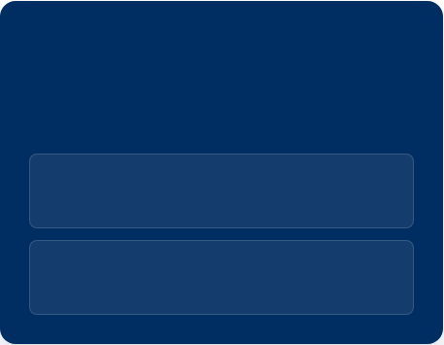
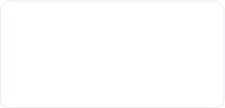
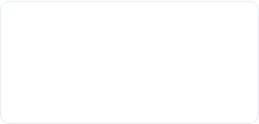
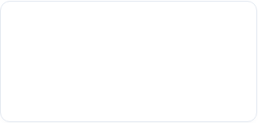
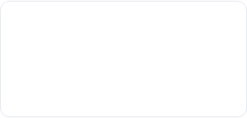
OFFLINE ENGINE & TECH STACK
Module Specifications
100% Offline Mode
ASR Recognition
Neural Translation
अनुवादिनी performs entirely on-premises without cloud dependencies or active internet connection pings.
Uses optimized CTranslate2 translation engines to drive up to 4x speedups on standard client CPU devices.
Meta's contextual network model, highly accurate across local Marathi, Hindi, and English regional frameworks.
LOCAL MODEL CACHING
AI weights are cached directly inside standard directory roots during setup to support offline initialization.
Speech Synthesis
Synthesizer
INT8 CPU OPTIMIZATION
CTranslate2 quantizes model execution weights, running easily on standard Intel CPUs without GPU acceleration.
An exceptionally fast, offline multi-dialect TTS synthesizer generating fluid regional audio on zero-latency footprints.
Handles split audio sync, video timeline reformatting, and hard-burns Devanagari font streams onto output files.

Slide 5

HOW IT MEETS EVALUATION PILLARS
Evaluation Pillar | Our Implementation Strength
🌍 Impact | Enables critical, direct, and multi-dialect educational manuals to easily reach rural Hindi- and Marathi-speaking agricultural communities.
📈 Scalability | Modular FastAPI core prepared to integrate chunk-based long video parsing and parallel inference pipelines without modifying core services.
🏭 Readiness | Handles automated CPU safety fallbacks, large files up to 2 GB, and cross-platform processing for Windows, macOS, and Linux out-of-the-box.
🎨 Usability / UX | Clean, drag-and-drop Streamlit UI. Offers instantaneous translation preview panels, dynamic subtitle track editing, and single-click outputs.
🔒 Safety | 100% offline local processing. Absolutely zero user inputs, transcripts, or field manuals leave your local corporate networks.
🤝 Inclusivity | Ensures robust accessibility through visual (dynamic subtitles) and auditory (AI voice overlays) regional language generation.
💰 Zero Cost | Built strictly upon open-source model weights. Completely free of perpetual licensing overhead or recurring cloud subscription bills.

Slide 6

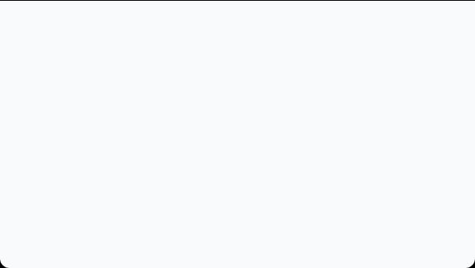



LIVE WALKTHROUGH DEMONSTRATION
WALKTHROUGH PREVIEW (demo.gif)
Full-context translation
Dynamic subtitle alignment
Multi-format media parser
Devanagari font rendering
Up to 2 GB file upload
Real-time preview stream
"अनुवादिनी transforms complex agricultural guidelines into highly accessible regional materials—anywhere, anytime, completely independent of the cloud."
Insert Walkthrough GIF Here
Replace this placeholder container in your final HTML code with your live recording to showcase live performance to the judges.

Slide 7



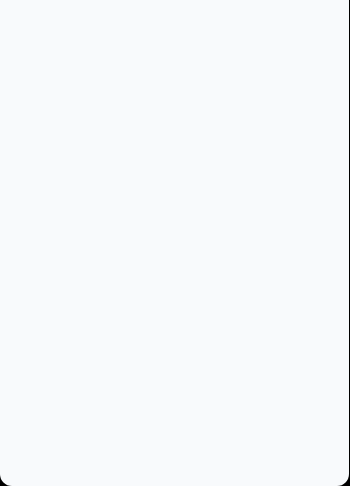





CORE APPLICATION INTERFACES
UPLOAD DASHBOARD
TRANSCRIPT TRANSLATION
RENDERED OUTPUT
Drag-&-Drop Screen
Editing Timeline Screen
Final Preview Player
Replace with of file upload interface.
Replace with of transcript side-by-side view.
Replace with of final translated player.

Slide 8


IMAGE SOURCES
https://images.splitshire.com/full/Ramu-the-Farmer:-A-Kid-Friendly-Animated-Village-Morning_Prre3.png
Source: www.splitshire.com
https://media.istockphoto.com/id/163018495/photo/real-people-from-rural-india-peasant-family-using-mobile-phone.jpg?s=612x612&w=0&k=20&c=Jwb9y49Z320y6t9j26TleVLNapJBq2uNsQcrA85KWCA=
Source: www.istockphoto.com

